Slide 1

Introduction to Reinforcement Learning w/ some applications to Energy
LEC 1b: Motivation and History
Instructors: Professor Scott Moura & Saehong Park
TA: Xinyi Zhao
Summer 2020

Slide 2
Motivation
What problems does RL solve?

Slide 3
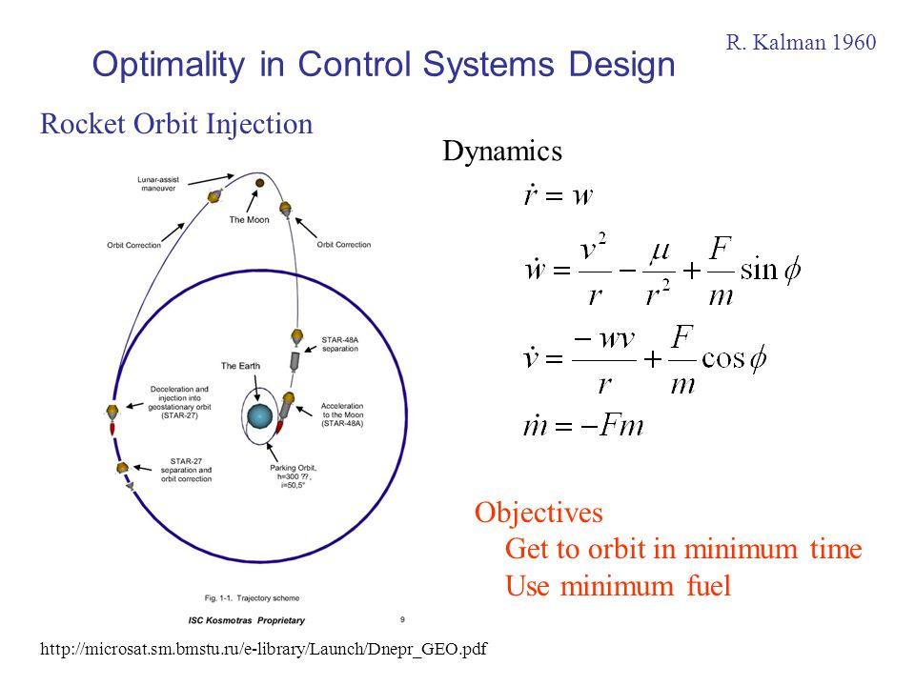
Example 1: Moonshot

Slide 4
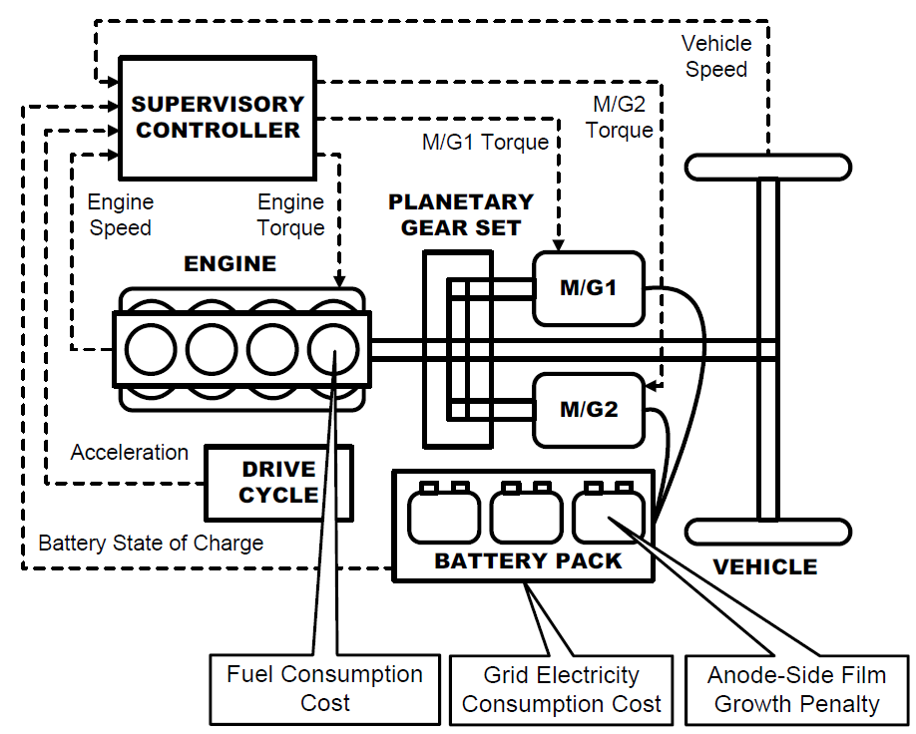
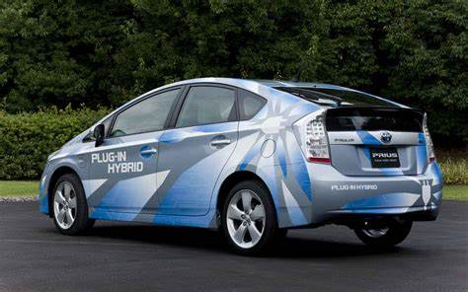
Example 2: Hybrid Vehicle Energy Management

Slide 5
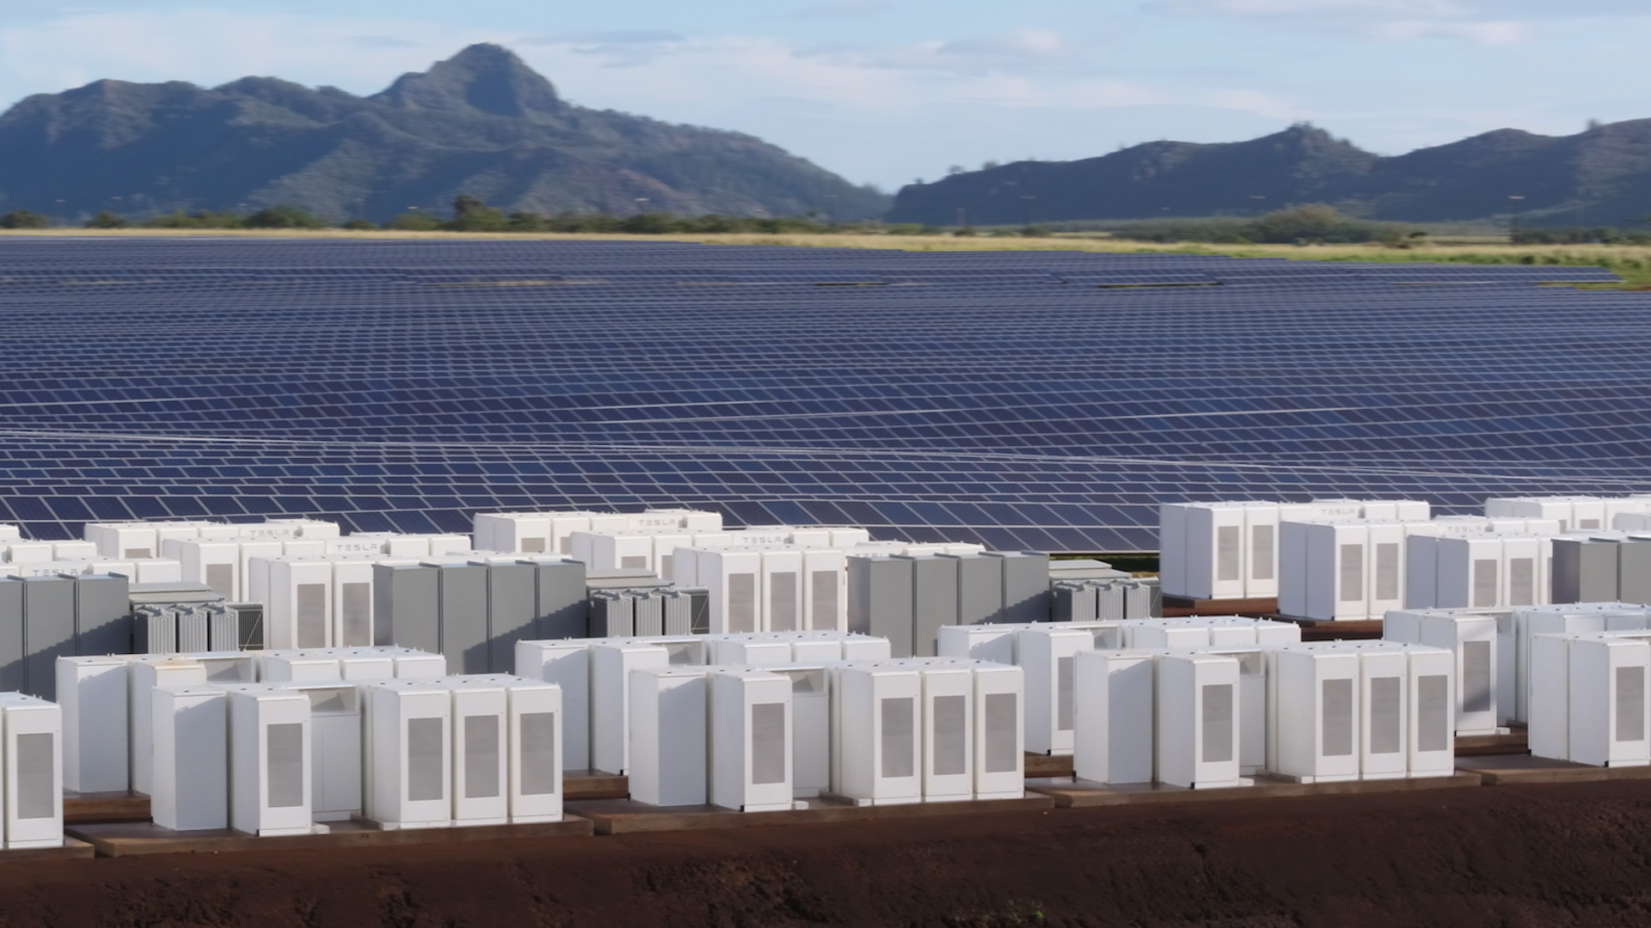
Example 3: Clean Energy

Slide 6

Example 4: My puppy Juno

Slide 7
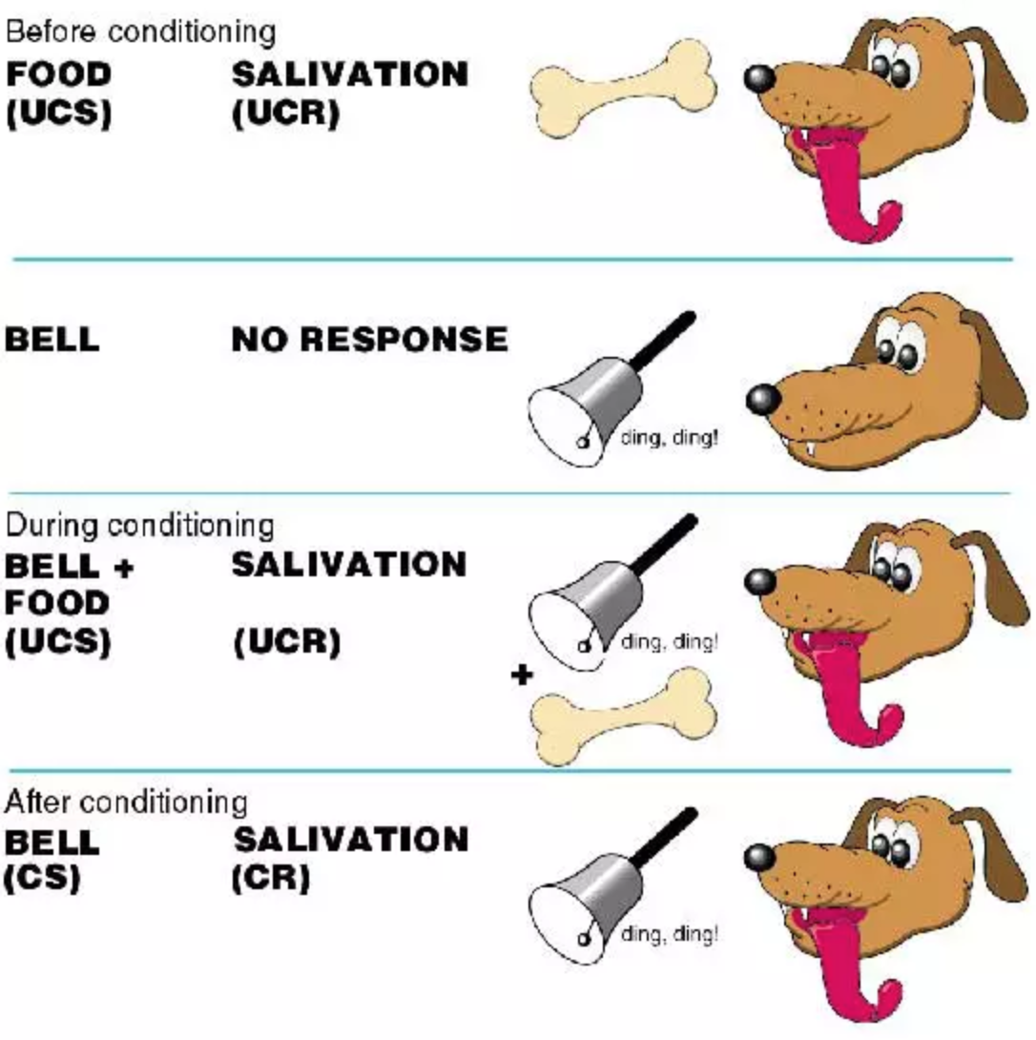
Short History – Ivan Pavlov (1890s)

Slide 8
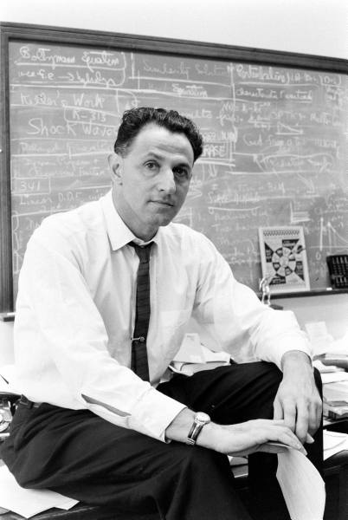
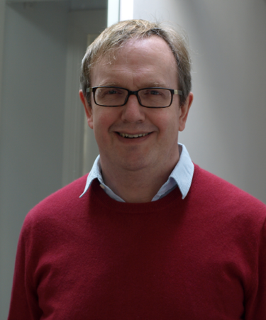
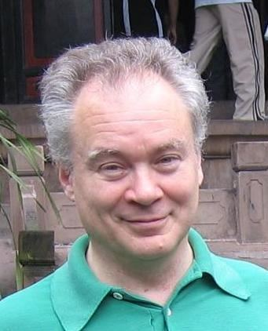
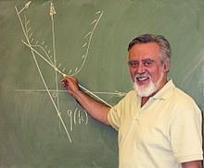
Short History – 20th Century
Richard Bellman – 1950s
Dynamic Programming
Markov Decision Processes
Optimal Control
Chris Watkins – 1989
Q-learning
Paul Werbos – 1970s-1990s
PhD Thesis: Backpropagation
”Heuristic Dynamic Programming”
Dimitri Bertsekas –
1990s-2000s
Dynamic Programming
Neuro-dynamic programming

Slide 9
Recent History – 21st Century
Richard Sutton
Dynamic Programming
Markov Decision Processes
Optimal Control
x
Q-learning
x
PhD Thesis: Backpropagation
”Heuristic Dynamic Programming”
x
1990s-2000s
Dynamic Programming
Neuro-dynamic programming

Slide 10
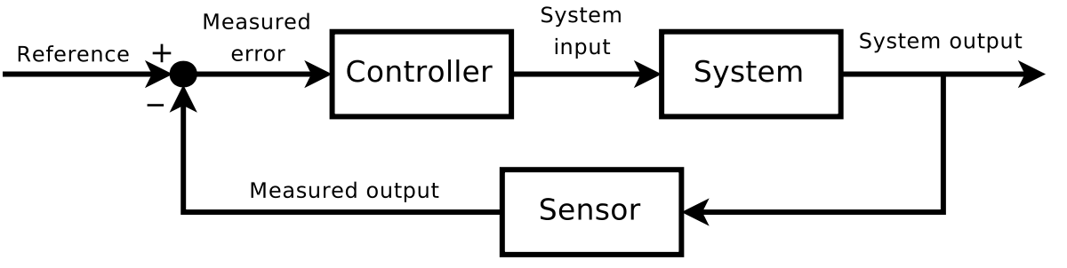
Problem Setup
Control Engineer view
Computer Science view

Slide 12
Key Characteristics of RL
Dynamic system
Reward/cost
Learning

